Slide 1
Building Vermont’s Moral Economy
Paul A. Cillo
Public Assets Institute
August 2015
www.publicassets.org

Slide 3
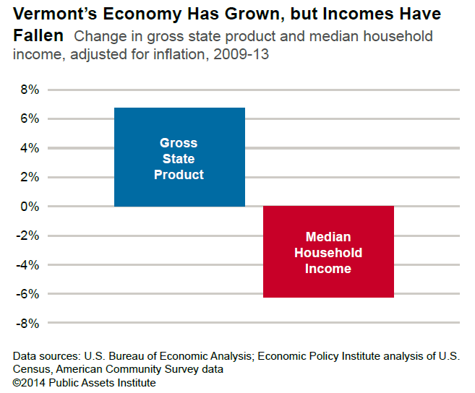
Notes:
After adjusting for inflation, the gross state product¹ increased nearly 10 percent between 2009, the official end of the recession, and 2013. That was the second-highest growth rate in New England for that period, and the 16th highest among all the states. But renewed growth in the overall economy hasn’t raised the income of many Vermonters. In 2013 median household income²—after adjusting for inflation—decreased for the second straight year, reaching its lowest level in 10 years, $52,578.
Chart revised Aug. 2015 to reflect BEA revisions to 1997-2013 GSP data.

Slide 4
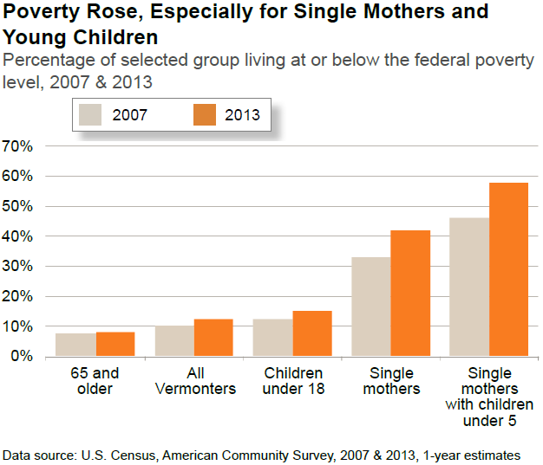
Notes:
Poverty rose among all Vermonters, but it hit children and single mothers the hardest. Between 2007 and 2013, the poverty rate for families headed by single mothers climbed above 40 percent. For single mothers with the youngest children, the increase was even greater.

Slide 5
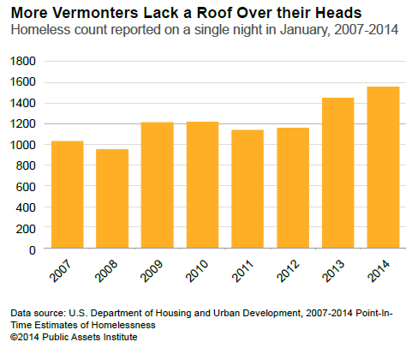
Notes:
For many Vermonters, the recovery has not translated into a permanent place to live. On a single night each January, the federal government conducts a state-by-state census of people in homeless shelters or sleeping on the streets. This annual estimate of homelessness has shown a rise in Vermont for the last two years. Since the recession started, homelessness has increased more than 50 percent.

Slide 6
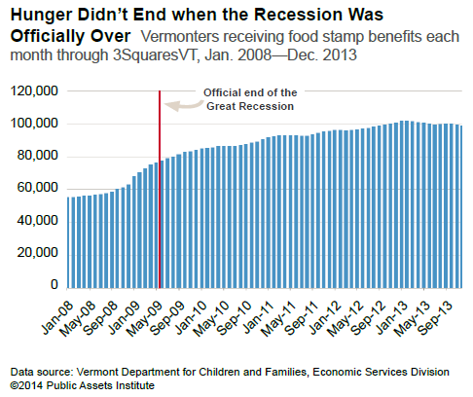
Notes:
Hunger has shown little sign of abating despite improvements in the economy. The number of Vermonters participating in the state’s food stamp program, 3SquaresVT, rose sharply in the early months of the recession. But even following the end of the recession, demand continued to rise. For 2013, an average of more than 100,000 Vermonters a month needed the 3Squares program to help them feed their families.

Slide 7
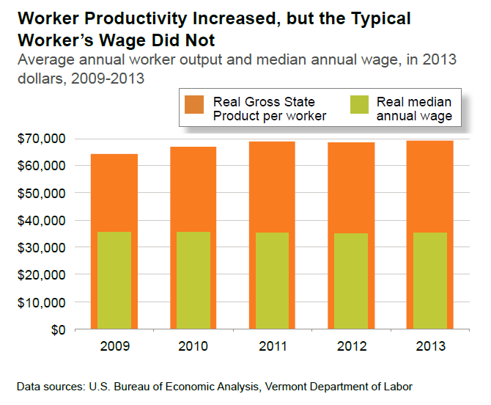
Notes:
Increased productivity is the means to higher profits for businesses, higher wages for workers, or lower prices for consumers—or, ideally, a balanced combination of all three.1 Worker productivity in Vermont increased following the recession. Adjusted for inflation, the average annual output per worker rose almost 8 percent from 2009 through 2013. But workers did not see the results in their paychecks. The real average annual wage across all occupations dropped 1 percent during the same period.

Slide 8
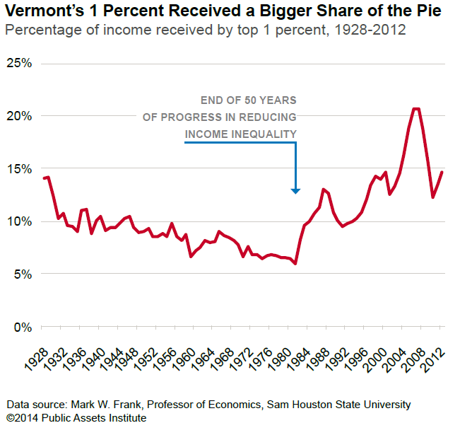
Notes:
As workers’ real compensation falls, their productivity gains are going to those at the top of the economic ladder. Between 1980 and the last recession, the share of income going to the top 1 percent of Vermont taxpayers more than tripled. By 2007, these households were receiving more than 20 percent of the income—a bigger share than in the late1920s, just before the Great Depresssion. During the recent recession, losses were concentrated in the upper income brackets, so the share going to the top declined. But the gap has started widening again. In 2012, the highest-income Vermonters were receiving almost 15 percent of the income, leaving a smaller share for everyone else.

Slide 9
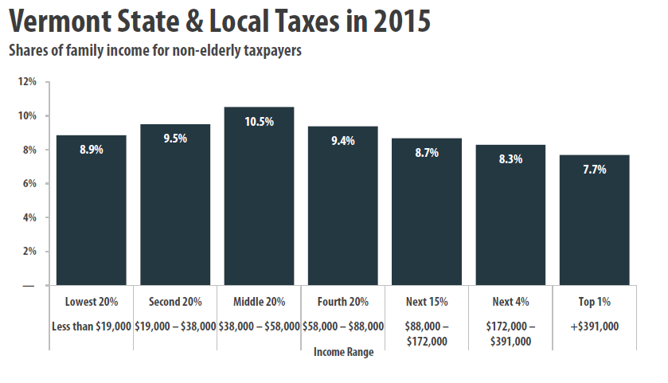
As a Share of Income, Total Taxes are Lowest for Vermont’s Wealthiest Projected 2015 state and local taxes as a percentage of 2012 income, by income range
Data source: Institute on Taxation and Economic Policy

Slide 10
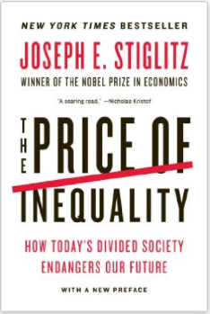

Slide 11
32 VSA § 306a. PURPOSE OF THE STATE BUDGET
(a) Purpose of the state budget. The state budget, consistent with Chapter I, Article 7 of Vermont’s constitution, should “be instituted for the common benefit, protection, and security of the people, nation, or community…” The state budget should be designed to address the needs of the people of Vermont in a way that advances human dignity and equity.
(b) Spending and revenue policies will seek to promote economic well-being among the people of Vermont, and foster a vibrant economy. Integral to achieving the purpose of the state budget is continuous evaluation of the raising and spending of public funds by systems of outcome measurement based on indicators that measure success in accomplishing the purposes of the state budget.
(c) Spending and revenue policies will reflect the public policy goals established in state law and recognize every person’s need for health, housing, dignified work, education, food, social security, and a healthy environment.
(d) As consistent with state law and in conjunction with the federal government, the budget will reflect support for economic development, public safety, transportation, and other infrastructure needs.
(e) Revenue measures shall also be based on the principles of sustainability and stability. The administration shall develop budget and revenue proposals as part of a transparent and accountable process with direct and meaningful participation from Vermont residents.

Slide 12
33 VSA § 1102
Purpose
The purpose of the Reach Up program is:
(6) to improve the well-being of children by providing for their immediate basic needs, including food, housing, and clothing;

Slide 13
Current Services Budget:
a projection of the real cost of the public services that our elected officials have committed the state to provide.

